Slide 1
Large Scale Graph Processing
DBMS Term Project

Slide 2
Database Squashers
Banoth Dinesh Karthik - 20CS30009
Pentamsetty Tharakeswar - 20CS10044
Saikat Moi - 20CS10050
Karamcheti Vamsy - 20CS30025
Dasari Giridhar Ram Chand - 20CS10022

Slide 3
Objective
The objective of this project is to process large graphs in a database using a graph processing system such as ApacheGraph, Pregel (GoldenOrb), Giraph, or Stanford GPS.
The objective of processing large graphs in a database has several practical applications in various fields such as social network analysis, web analysis, bioinformatics, and cybersecurity.

Slide 4
Methodology
Apache Spark Server:-
Apache Spark is a distributed computing framework that is designed for processing large-scale data sets. It provides an interface for distributed data processing that can be used to perform various operations such as batch processing, stream processing, machine learning, and graph processing.
Pagerank.scala:-
The pagerank.scala code uses the Apache Spark GraphX library to compute the PageRank algorithm on a graph dataset. The graph dataset is loaded from an edge list file using the GraphLoader.edgeListFile method, which creates a Graph object with vertex IDs of type Long, edge attributes of type Int, and vertex attributes of type Int.

Slide 5
Methodology
Profile_performance:-
The profile_performance.scala code is used to profile the performance of loading a graph using Apache Spark GraphX. The ThreadMXBean class is used to get information about the CPU utilization of the current thread.
Query_processing.scala:-
The query_processing.scala code uses the Apache Spark GraphX library to achieve our goal. The code performs the steps like loading the graph, providing he menu of options, performing a total of 7 graph queries based on the user's choice and profile performance.

Slide 6
Results/Screenshots

Slide 7
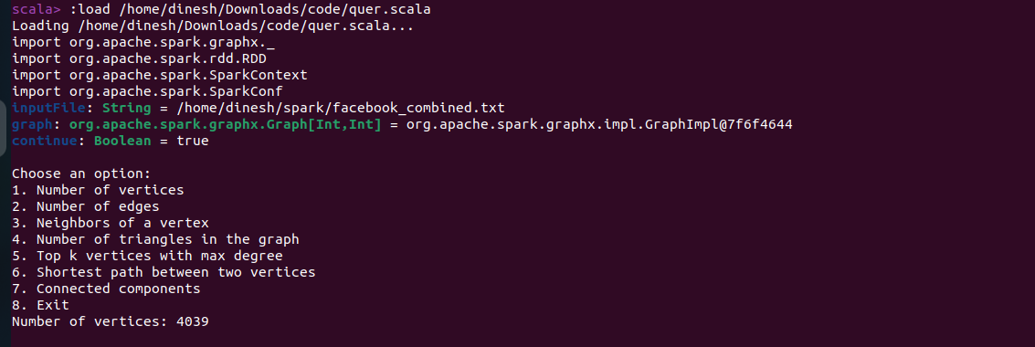
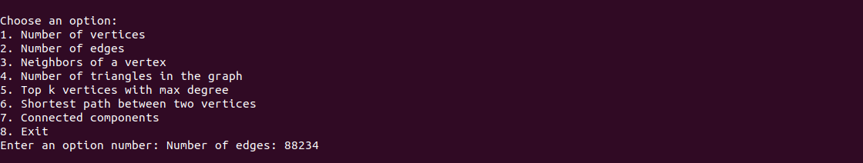

Slide 8
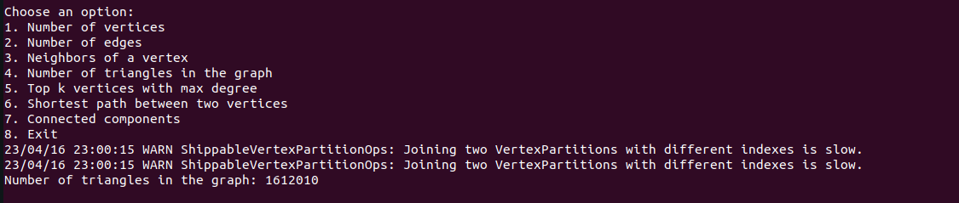
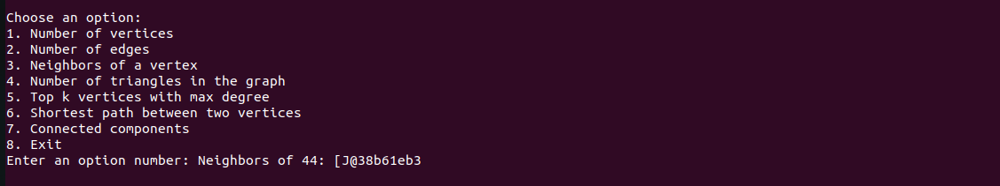
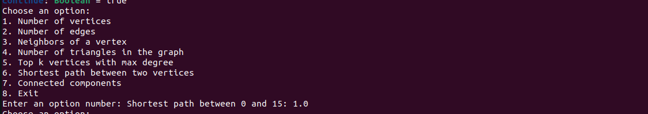

Slide 9
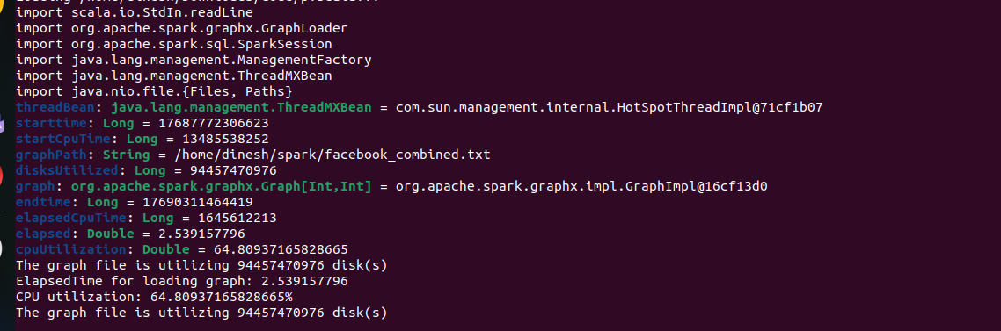
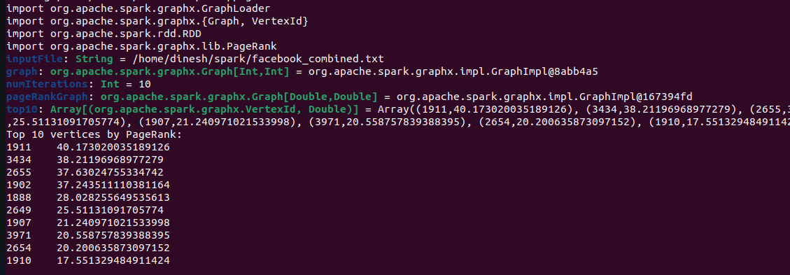

Slide 10
Thank you

